Slide 1

Intro to CS

Slide 2
Who is Matthew?
Programming for ~10 years
Built websites and applications used by thousands of people
SOTA machine learning research at Intel Labs
Speech recognition, etc.
Wrote the language we’re using today

Slide 3
What is programming?
Question:

Slide 4
Program your partner
Activity:

Slide 5
What is programming?
Discuss:

Slide 6
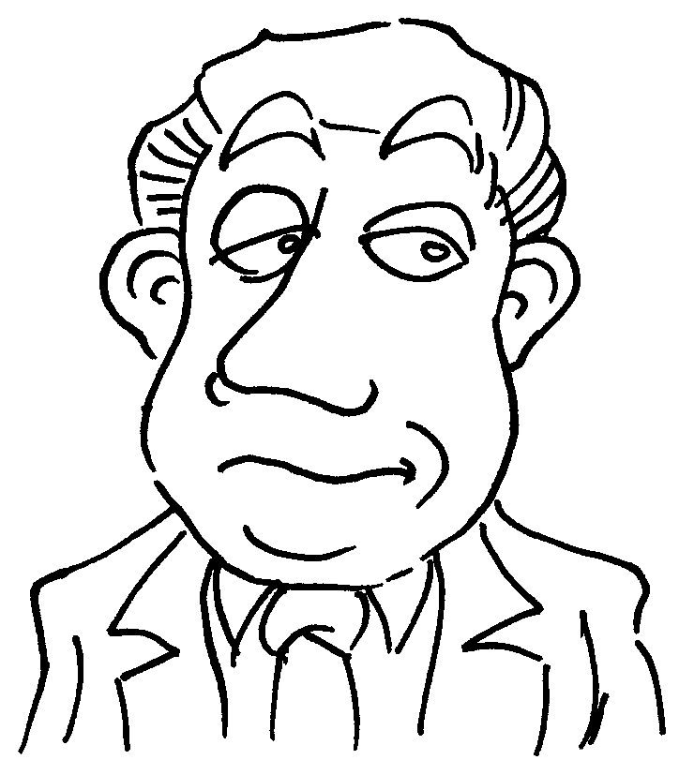
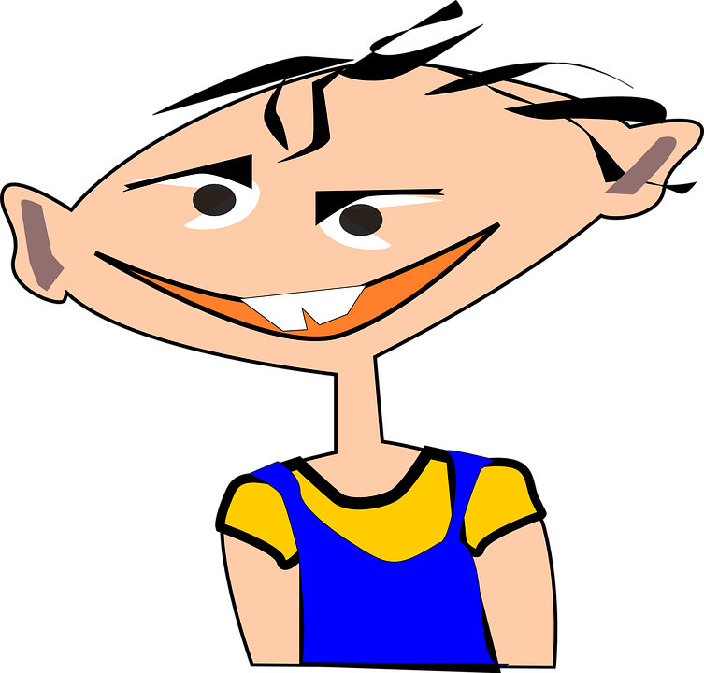
What is programming?
Speaking

Slide 7
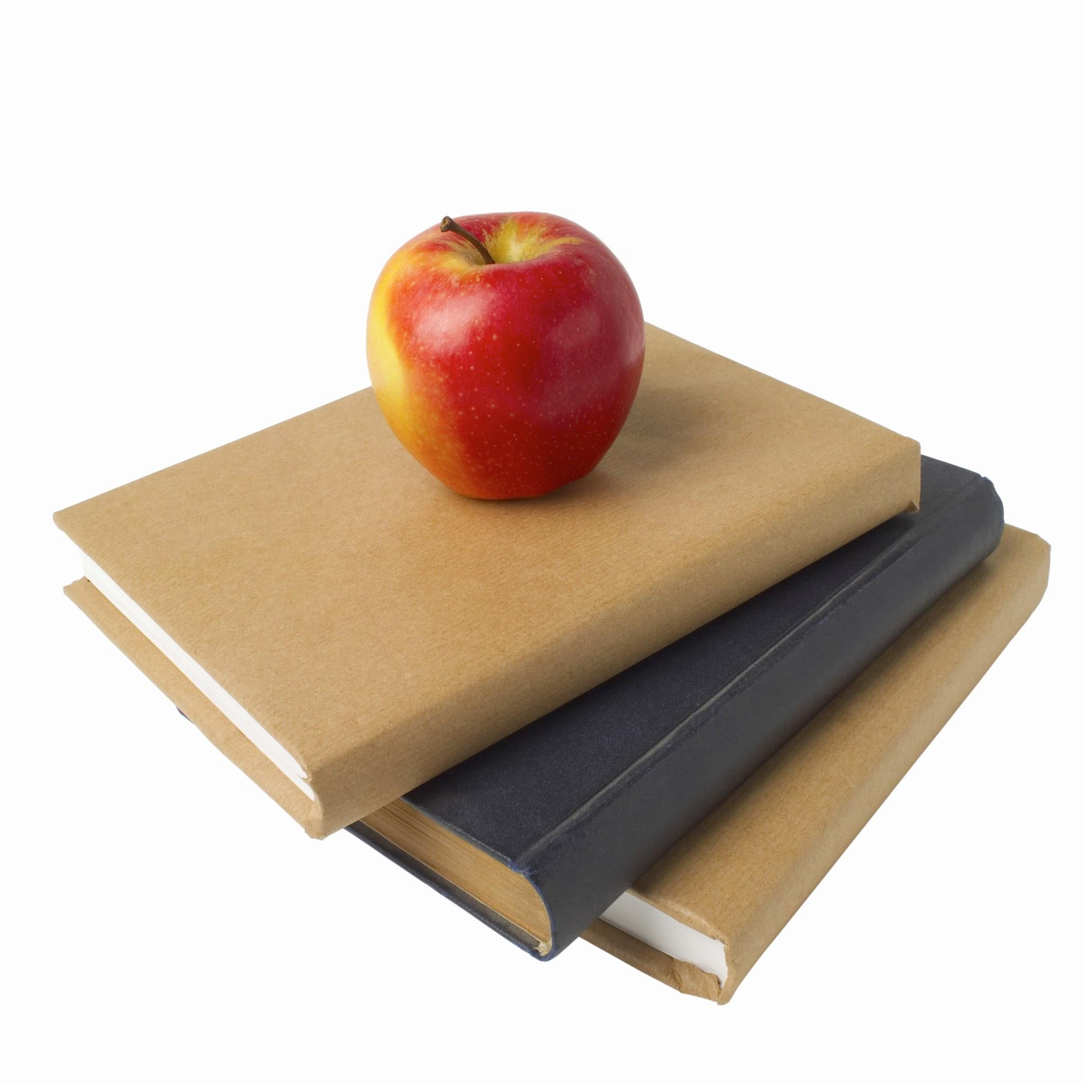
What is programming?
Writing

Slide 8
What are computers?
Question:

Slide 9
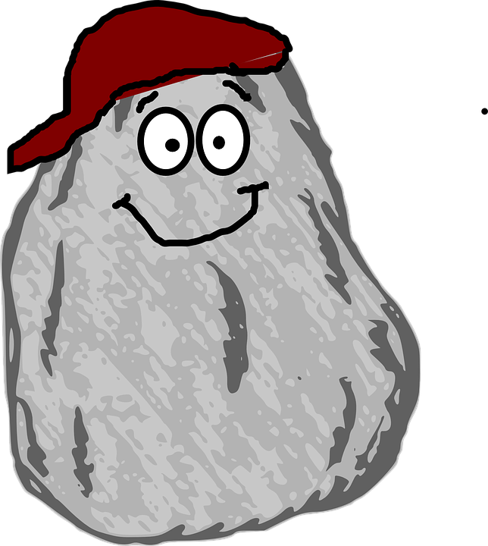
What is programming?
Programming

Slide 10
What is programming?
Communicating with the computer
Getting it to do something/follow instructions
Use special languages understood by both

Slide 11
What is programming?
In your own words:

Slide 12
Why learn programming?
Question:

Slide 13
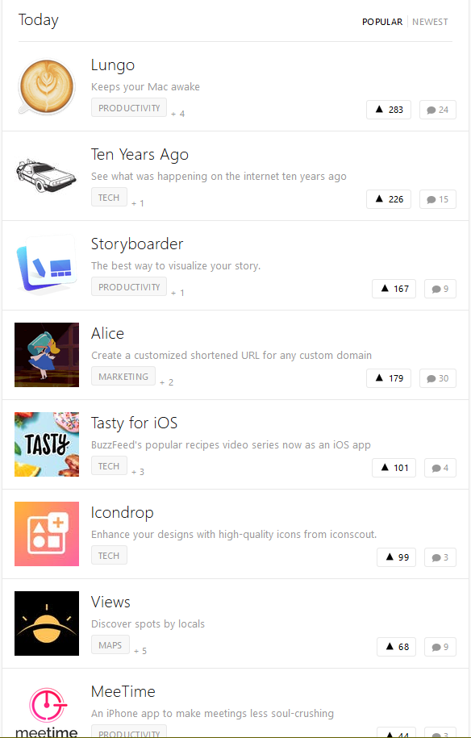


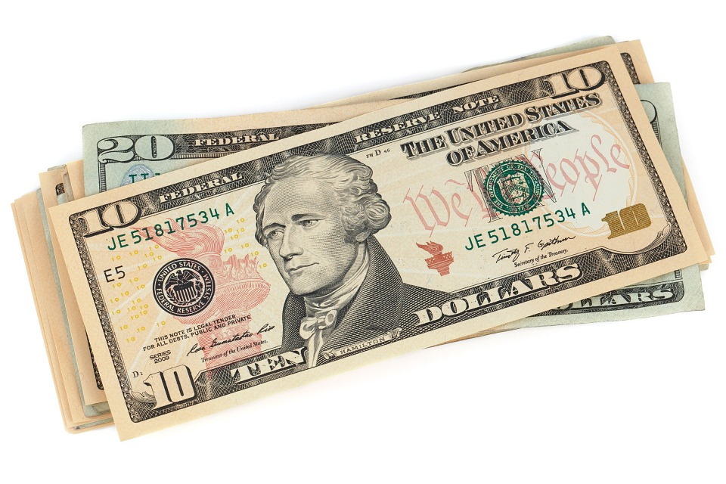
Why learn programming?

Slide 14
Computer Science
Why learn programming?

Slide 15
What is ‘good’ programming?
Course Question:

Slide 16
“Good Programming”
var a=0,b=1,c;for(write("Fibonacci");b<=10;)write(c),c=a+b,a=b,b=c;
var a=0, b=1, c;
write("Fibonacci");
while (b<=10)
{
write(c);
c=a+b;
a=b;
b=c;
}

Slide 17
End Goal of This Week
Make Projects - Hangman, Odds Are, etc.
Foundational understanding
Something to build off of

Slide 18
Stretch
Enjoy:

Slide 19

Stereotypes
Notes:
Stereotypes of programming/computer science - guy sitting typing in 0s and 1s

Slide 20
Solving Problems
Requires an understanding of abstractions

Slide 21

Abstractions
Fundamental Concept
Build up, like a building
“Limited scope of interest”

Slide 22
Our Abstraction
Values
Functions

Slide 23
Values/Variables
Three parts:
Type of data (text, number, etc.)
Can’t do math on text
The actual value
“Hello”, 42, etc.
Name to reference it by
No spaces, quotes, etc.

Slide 24
Functions
Like machines - they take in some values, then they output a new one
(Usually) don’t need to worry about what they do ‘inside’

Slide 25
Function Machines
Activity:
Average of two numbers

Slide 26
Break
Enjoy:

Slide 27
Programming Languages
Many different ways to represent the same thing
“Je suis” vs. “me llamo”
We’ll use two:
YAEPL
Javascript

Slide 28
Function Machines
YAEPL:
Notes:
Maybe not?

Slide 29
YAEPL Reference
Syntax: function-name (inputs) -> (output-name)
Inputs can be text (“use quotes”), numbers (5), or variable-names
Functions:
write
prompt
str-to-num
add, subtract, divide, multiply

Slide 30
Odds Are
Activity:

Slide 31
Example Dares
Tickle Matthew
Stroke Adhiv’s hair for 30 seconds
Tell Will your funniest joke
Tell the person next you they’re beautiful
Dance to a song with Will for 10 seconds

Slide 32
YAEPL Lists/Arrays
Hold multiple different values
Can access any one value with its index
Create: copy [] -> (array-name)
Add item: array-push (array-name) (item)
Get item: array-el (array-name) (index) -> (item)

Slide 33
YAEPL Jumps
Use labels to mark certain points in your code
Jump instructors can “jump” to those labels
jump-if condition #label only jumps if condition is true

Slide 34
#start:
prompt "Number one:" -> number1
str-to-num number1 -> number1
prompt "Number two:" -> number2
str-to-num number2 -> number2
eq number1 number2 -> are-eq
jump-if are-eq #success
jump #failure
#success:
write "Numbers are equal!"
jump #end
#failure:
write "Numbers are not equal :("
jump #end
#end
write “Let's try again!”
jump #start
YAEPL Jumps

Slide 35
YAEPL Reference
Syntax: function-name (inputs) -> (output-name)
Functions:
write-str
prompt-str
str-to-num
add, subtract, divide, multiply
copy, array-push, array-el
rand-num
jump, jump-if

Slide 36
Odds Are
YAEPL:

Slide 37
Homework
Find something you do every day and write a recipe for it
Program:
“I like…”

